Slide 1
Voting Process
1
2
3
How to nominate
When to vote
Where to vote
A nomination form must be submitted to the chairperson of the Nominations and Elections Committee
It will be the last agenda item during the business meeting
QR CODE will be provided

Slide 2
Represented States
Connecticut
Massachusetts
Vermont
New Hamshire
Maine
Rhode Island

Slide 3
Nomination Process From Section 3: Election
Nominees
All nominees must be a current member of the New England Educational Opportunity Association (NEOA)
Nomination Requirements
The chairperson of the Nominations and Election Committee must receive in writing a nominating form (available online or at the Assembly) with the name of the nominee and the office to which s/he has been nominated and said form must be signed by at least three active members of the association (NEOA)
Nominations Phase
The committee may solicit nominations through a direct paper or through electronic mailing to the chairperson of the Nominations and Election Committee (poter@wcsu.edu)
Elections Phase
Officers are elected by the eligible NEOA members and installed at the Delegate Assembly. All elected officers will assume their term starting September 1 of the current year. The election of officers will be accomplished through voting, either by absentee ballot (submitted to the Chairperson of the Nominations and Election Committee and postmarked at least ten days prior to the Delegate Assembly) or at the Delegate Assembly or, when necessary, through electronic means.

Slide 4
Board Member Positions
President - Elect
Treasurer
The President-Elect functions as "President in training." Responsibilities include:
Fundraising coordination
Leading the COE Fair Share campaign
Coordinating state liaisons
Addressing COE issues
Attending board meetings
Overseeing development efforts
Creating regional structures to enhance state coordination.
Additionally, the role involves:
Identifying professional learning needs
Dedicating resources to support state associations
Encouraging board members to recruit and mentor individuals for leadership roles.
The Treasurer is responsible for:
Managing the receipt and expenditure of funds in accordance with the Board's fiscal policies
Maintaining detailed financial records
Providing quarterly reports to the association.
Additionally, the Treasurer plays a crucial role in:
Creating and maintaining a financial management plan
Including establishing an annual budget
Monitoring fiscal status
Ensuring compliance with state and federal filing requirements.
Secretary
Vice President (Conference Chair)
The secretary is responsible for officially recording Board meetings and incorporating the Treasurer's reports into Association reports. The role involves:
The Vice-President is primarily responsible for organizing and chairing the annual NEOA conference, with duties including:
Selecting the conference site
Negotiating contracts
Developing the conference budget
Coordinating various aspects of the event
Additionally, the role involves:
Liaising with state associations
Addressing professional learning needs
Promoting leadership opportunities within the board, while also contributing to national advocacy issues such as COE's Fair Share initiatives.
Attending board orientation and four additional meetings
Recording detailed minutes, including attendance and the Treasurer's report, for both board and annual business meetings.
Serving on committees as assigned
Typing and distributing minutes to board members
Actively participating in board activities/discussions
Contributing relevant information to the NEOA newsletter

Slide 5
State Liaisons
The State Liaisons shall be full members of the Association Board of Directors and shall be elected by and represent the interests of the NEOA members in their respective states.
Annual priorities include coordinating crisis mobilization strategies at the state and regional levels, participating in state level action plans, disseminating information about NEOA and COE within the state, coordinating state policy events and state participation in national policy seminars, and reporting to the state on NEOA activities.
Principal Responsibilities:
Attend board orientation (September) and four (4) board meetings: September, December, February, April and June
Represent NEOA members on Board and provide a written report of activities in the state at Board meetings in conjunction with state president
Report to state on regional activities
Represent NEOA at state organization meetings and disseminate information from NEOA
Coordinate crisis mobilization strategies at state and regional level
Initiate and support interaction between TRIO and EOP personnel and state/federal legislators in conjunction with state president
Serve on NEOA membership committee
Maintain E-mail, phone, fax tree and other communication systems
Actively contribute to and participate in all board activities/discussions
Contribute information to the NEOA newsletter as appropriate

Slide 6
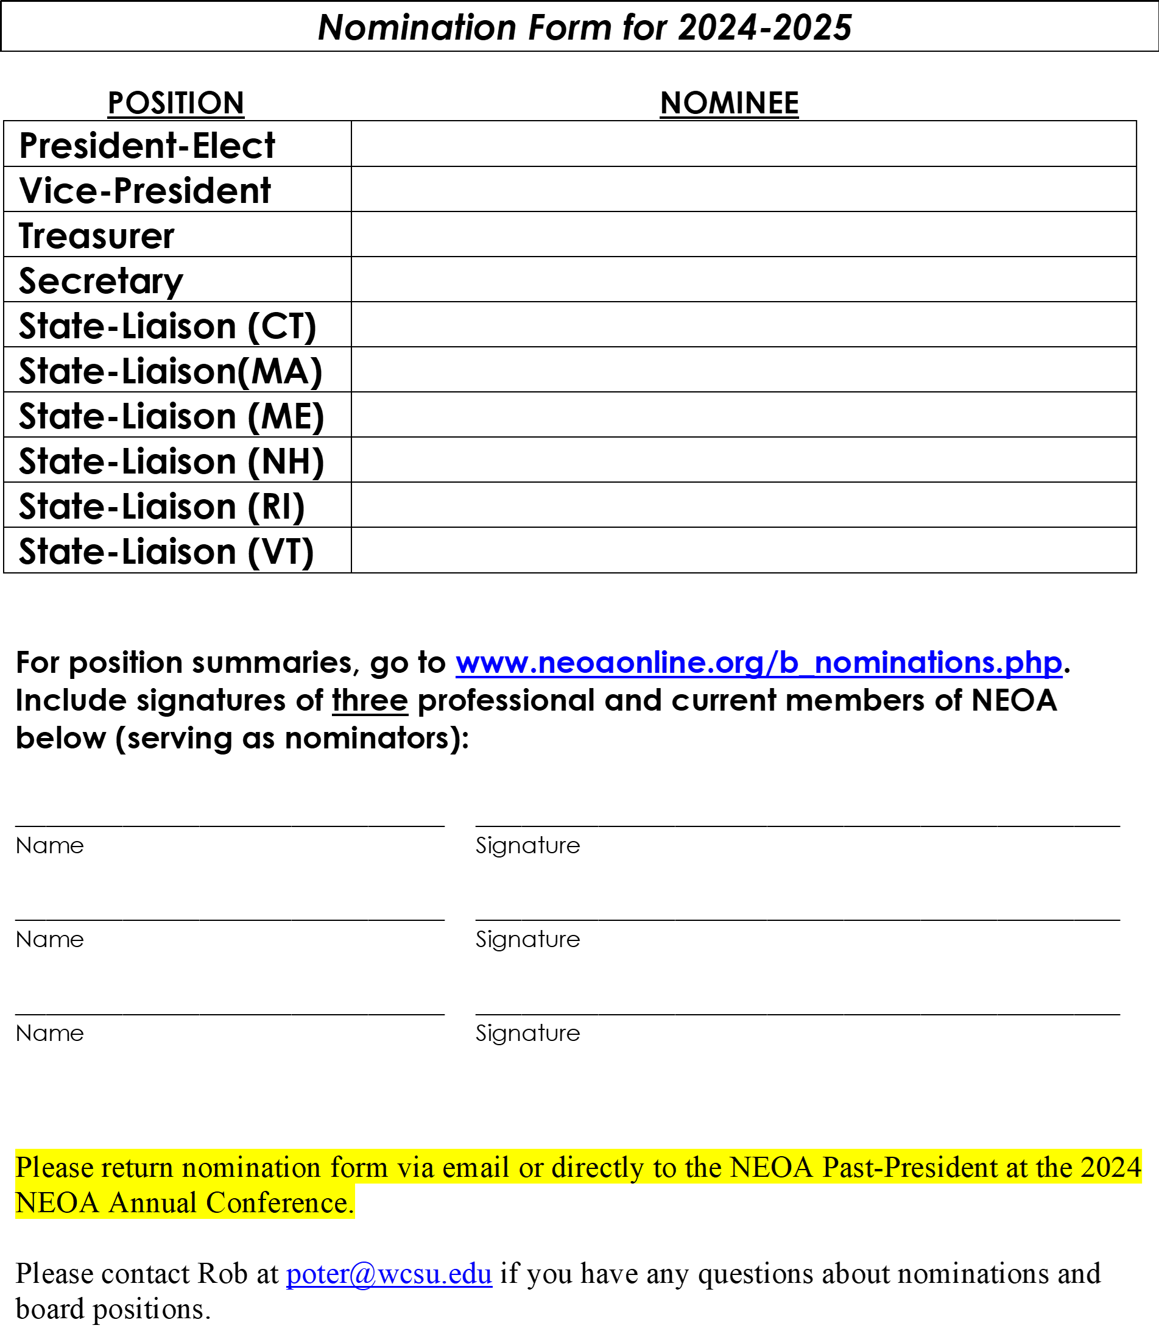
Nomination Form for 2024-2025

